Slide 1

APPLICATION OF DATA SCIENCE
EXPLORING REAL LIFE IMPLEMENTATIONS ACROSS INDUSTRIES
BY: AYANKA JESSELYN.

Slide 2
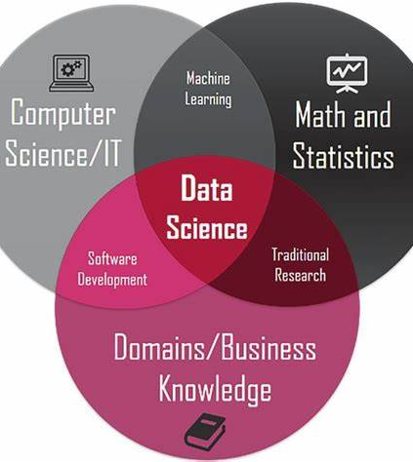
INTRODUCTION
WHAT IS DATA SCIENCE?
It is an interdisciplinary field that combines the use of statistics, machine learning, and algorithms to extract insights and knowledge from data.
Core components of Data Science Includes Data Mining, Data Cleansing, Machine Learning, Data Visualization, Data Analysis.

Slide 3
BUSINESS
HEALTHCARE
TRANSPORTATION
APPLICATION
OF
DATA
SCIENCE
SPORTS
FINANCE
AGRICULTURE

Slide 4

DATA SCIENCE IN HEALTHCARE
Predictive analysis
Wearable devices such as smartwatches, leveraging IoT for connectivity.
Virtual assistance
Medical imaging analysis
Genomics
Monitoring patient health

Slide 5

DATA SCIENCE IN BUSINESS
Recommendation systems for consumers
Price optimization
Streamline manufacturing
Location of business
Fraud detection
Customer Sentiment analysis
Predict market trends

Slide 6

DATA SCIENCE IN TRANSPORTATION
Route optimization
Management of road safety
Traffic control
Airspace management
Automobile manufacturing

Slide 7

DATA SCIENCE IN FINANCE
Risk management for loans
Algorithmic trading
Trading analysis for stock market, FX, crypto etc
Fraud detection
Customer data management

Slide 8

DATA SCIENCE IN AGRICULTURE
Detecting diseases
Automating irrigation
Risk management
Predicting weather
Managing resources

Slide 9

DATA SCIENCE IN SPORTS
Player performance analysis
Predictive outcomes
Sales and Marketing

Slide 10

CONCLUSION
Data Science has become a vital part of multiple industries and insights are used to:
Improve efficiency
Make profit
Mitigate risk
Data driven decision
Fraud detection
Improved customer experience.

